Slide 1
Prototype of Hexa-copter
Presented By :
1.Adarsh Pandey
2.Sahil Goankar
3.Jayesh Wagh
T.E. (Computer Engineering)
PIN:EN3219
Semester-III
Guided By : Priyanka Deshmane

Slide 2
ABSTRACT
Unmanned Aerial Vehicles, or drones, are a topic of interest to many academic and industrial research organisation. They find applications in several fields, ranging from military functions to civilian functions .Consequently, the UAVs are expected to perform a wide range of missions, which necessitates a certain level of autonomy .An autonomous UAV relies on an efficient control architecture to perform various tasks and make appropriate decisions .In robotics, control architectures are categorized under six classifications, as we list: deliberative, reactive, hybrid, behaviour, hybrid behaviour, and lastly subsumption architecture. Through this paper, we introduce a short review on a particular type of UAV called Hexacopter or Hexarotor , in which we discuss the items that compose the hexarotor from the very fundamental (framework, sensors …) to the most elaborated parts (modelling , control…) .The document covers the flight mechanism, the avionics sensors, the dynamic modelling , and the various control techniques used on a hexacopter .The vision system, the different localisation , and navigation techniques are also explored. At last, but not at least, the focus is directed toward the investigation of the robotics control architectures.

Slide 3
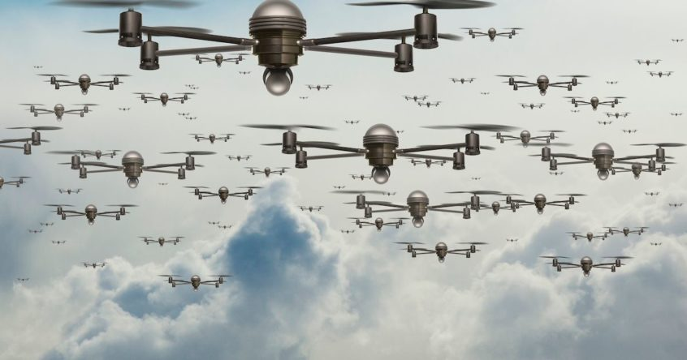
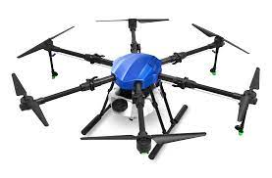
INTRODUCTION
The Drone are the UAV which are mostly use for the Surveillance purpose and other major sector and industries. Hexa-copter are the most widely use for the huge payload carry and high range performance purpose. But here one hidden secret related to UAV are the often powerful and strenght as compare to other Drone(i.e. Quard-copter and two propeller copter).
Well, frame designing and Electronic and Computer programming are the three major categories. Which are having their own importance. But, in this project section we will going to focus into the Frame and Prototype of Hexa-copter as well as all software and assembling related part.
Overview and the basic Concept of Unmanned Aerial Vehicles:-

Slide 4
Existing System
Here, current scenario system which are used for fulfillment of user requirment such as film shooting and heavy payload for carry are done by quardcopter and unmanned arial vehicles. In nowadays scenario , Drones and UAV are not so much used for general people.
Existing system of quardcopter require less voltage as compare to the hexa-copter drone power supply. But this is because the microcontroller of the quardcopter are design as per the frame body carries capacity and motors that are used. But where as, Strong UAV are having high voltage of supply for the motors and circuit provided the addition 12 voltage value.
User or organization are facing high latency network problem in the long arial survillence and low payload problem in the existing system etc. Hence, hexa-copter are the solution for this kind of issue. Hence, it increase the GSM connection with low latency and high payload. Hence, their will be always exception related to Flight computer for every upcomming drones and sytem.

Slide 5
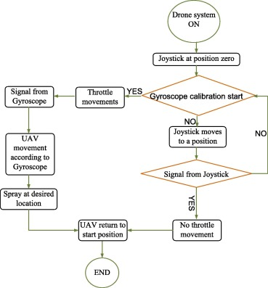
OVERALL SYSTEM(Exiting System) Diagram:-

Slide 6
PROBLEM DEFINITION
What challenges do Unmanned Aerial Vehicles(i.e. Hexa-Copter) Face?
Safety:- Like recreational drone, commercial unmanned aerial vehicles rely on global positioning technology for navigation. This gives controllers an accurate read on the location of a vehicle, even at a significant distance.The issue, however, is that the GPS can fail to alert controllers of what’s in the surrounding area. Without the ability to recognize other airborne objects, unmanned aerial vehicles can interfere with the flight patterns of other aircraft and pose potential safety threats. Geo fencing helps to address this issue by creating a virtual fence that drones adhere to. These programmed no-fly zones keep unmanned systems away from restricted areas and heights where they could interrupt manned aircraft activity.
Privacy:- With so-called “eyes in the sky”, unmanned aerial vehicles can collect an abundance of data. In addition to video surveillance, the systems might also include sensors that detect sounds, magnetic fields and chemical composition, among other information.On a fundamental level, the public can view this collection of data as intrusive, almost as if they are being spied on. These concerns over personal privacy have prompted federal legislation to be introduced.One example is the Drone Aircraft and Transparency Act of 2017.

Slide 7
This proposed act would mandate that commercial drone operators provide details about the use of their technology as well as how they will leverage personal information about individuals.
Security:- As unmanned aerial vehicles collect and share data, it’s possible that other sources may attempt to jam or hack its signals. With the fear that sensitive data may end up in the wrong hands, this can create further anxiety and frustrations amongst the public.
RF shielding is one way to ensure greater security of this data in unmanned aerial systems. By building an enclosure around the vehicle, you can reduce transmissions that make its signals more vulnerable to other sources.
Power:- When unmanned aerial vehicles are able to stay in flight longer, their economic impact is greater. For instance, they can deliver packages and medicine to more distant places, cover larger stretches of area in mapping applications and efficiently perform infrastructure surveillance.
While advancements in battery and engine technologies are crucial for longer flight times, the weight of unmanned aerial vehicles is also an important consideration. By designing and manufacturing lightweight parts for your system, it’s possible to achieve longer flight times and advance the applications of your technology.

Slide 8
FEATURES
Feature of Hexa-Copter(UAV):-
Stability & Control
Wireless connectivity
Greater Power
Real-Time Feedback
Advanced Photography
Upgraded remote control
User Interface data representation by Drone
Special Survillence Camera

Slide 9
FUTURE SCOPE
Drone are used in various fields. Areas in which drone can be used are construction, defense , photography ,marketing ,delivery ,agriculture , rescue , entertainment etc.
In these field drone are playing a vital role and making things easier and efficient.
Due to some drone flying restrictions, it is not being used to its full potential.
India has a recorded of 19,553 drones. While the world use more than 16 lakhs drones by 2020.
There are various drone technologies used for various purpose. Let us discuss the importance of drone technology and the best uses for drone.
Drone have long been predicted to revolutionize cargo delivery. In theory, models capable of carrying a large payload should become a more efficient alternative to light transport vehicles and helicopters serving hard-to-reach area.

Slide 10
HARDWARE REQUIREMENTS
Component required for Hexa-copter(Drone) is divided as follows :-
Mechanical Part
Electrical and Electronic Part
Computer Programming Part
Prototype(Frame)
Arduino nano/Uno
Arduino Programming
ESP32 board
Propellers
MPU 6050
C-programming/C++
Screw
GSM Antennas
Motors
Data Structure and Algorithms
Breadboard
Camera
Sensor
Beagle Board

Slide 11
SOFTWARE REQUIREMENTS
This Requirement are going to Divide into a Two part one is the Design(Building) Requirement and another one is the Software requirement. Let discuss now.
Design or Building the GDS:-
C/C++ Programming
Data Structure and Design and Analysis of Algorithms
Arduino Programming
Scretch
Software are going to use:-
DASSAULT SYSTEMES:-
SolidWorks
Arduino IDE 2.0.4
Proteus 8 Professional
Matlab Software
Autodesk Fusion 360

Slide 12
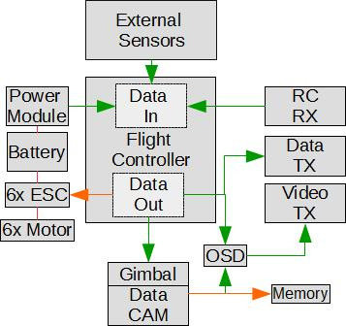
SYSTEM ARCHITECTURE
Fig.1 System Architecture of Flight Controller

Slide 13
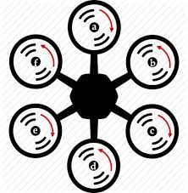
Fig.2 Diagram of Hexa-Copter Propeller

Slide 14
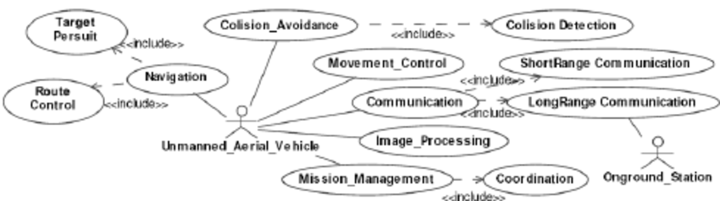
USE CASE DIAGRAM
Fig.1 Use Case Diagram of UAV

Slide 15
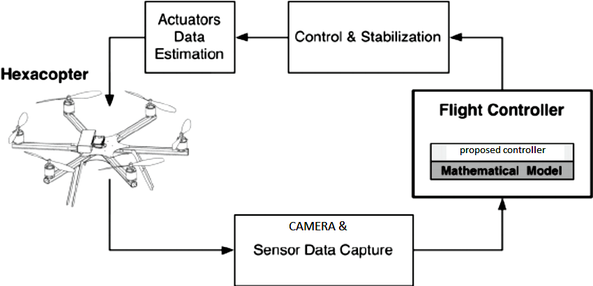
Fig.2 Use case Diagram of Flight Controller

Slide 16
CONCLUSION
The application areas of multi rotor UAVs have been increasing day by day all around the world. There are prospects of such new and emerging technology in Asia and Asia pacific region for socio-economic development. For developing countries, employing helicopters and other large aircrafts for different purposes like surveillance, rescue mission, etc. is a challenge from the economic point of view. Similarly, such missions also involve great risk of human lives. As an alternative, the developed Hexa-Copter using the frame locally made of Microcontroller board and off-the-shelf purchased electronic parts is very stable, robust, easy to operate and maintained. After a number of successful test flights and public demonstrations, it is now fully functional and ready to take off the payload for different application.
In this project we are mainly focus on developing prototype and Assembling of electronic component and sensor and actuator for the designing of professional Drone. This project is might take a 1 year of duration for research and development.
In this semester, we are focusing on mechanical part of hexa-drone, which is the first phase of the development part of the project. But one constraint related to cost of the project are always exist.

Slide 17
REFERENCES
1. Modelling and control of a largequadrotor robot[J]
:https://doi.org/10.1016/j.conengprac.2010.02.008
2.Design of UDE-based Controllers from Their Two-Degree-of-Freedom Nature
:-https://doi.org/10.1002/rnc.1674
3.MUDE-based control of quadrotor for accurate attitude tracking
:https://doi.org/10.1016/j.conengprac.2020.104721
4.Control allocation—A survey :-
https://doi.org/10.1016/j.automatica.2013.01.035

Slide 18
THANK YOU

